Slide 1


Hands on Data Science mike ames amesam@wfu.edu
Wake Forest
School of Business
_______
AUC

Slide 2
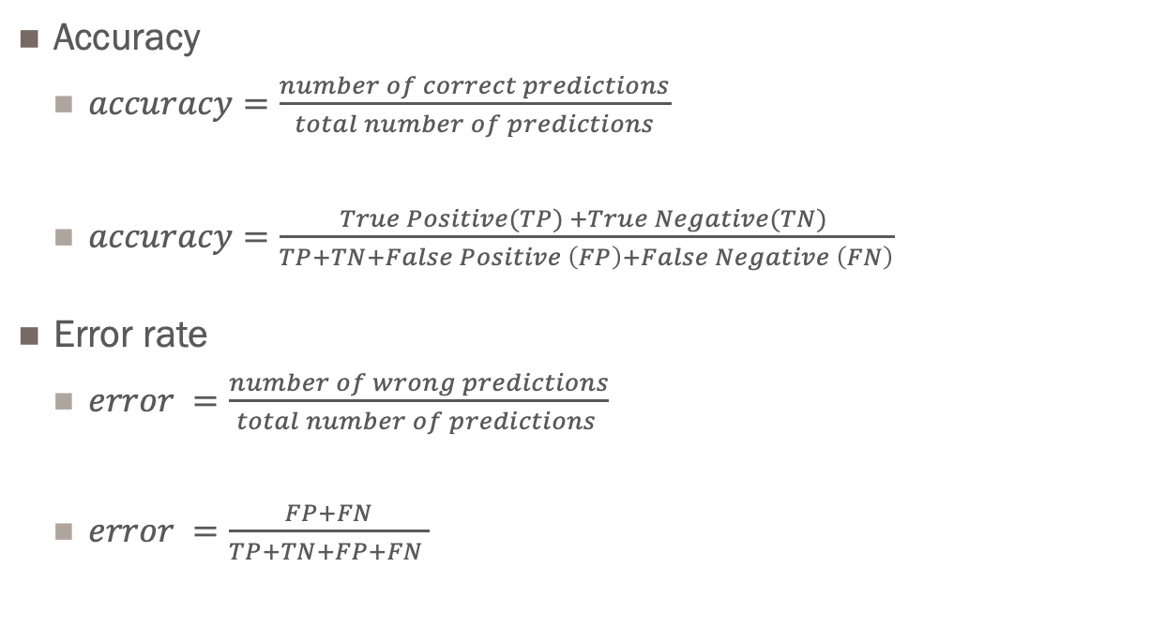
Binary Classification
Evaluation Accuracy & Error
Accuracy
$accuracy=\frac{number of correct predictions}{total number of predictions}$
$accuracy=\frac{True Positive(TP) +True Negative(TN) }{TP+TN+False Positive \left(FP\right)+False Negative \left(FN\right)}$
Error rate
$error =\frac{number of wrong predictions}{total number of predictions }$
$error =\frac{FP+FN}{TP+TN+FP+FN }$
Accuracy is a good measure IF the data is balanced i.e. 50/50 split between classes, in that case expected accuracy is 50% a coin flip for example.
The reality is that most problems are imbalanced meaning a majority and a minority case ex. 10:1, 100:1 in which case you can be 90 – 99% right by assigning everyone to the majority case.

Slide 3
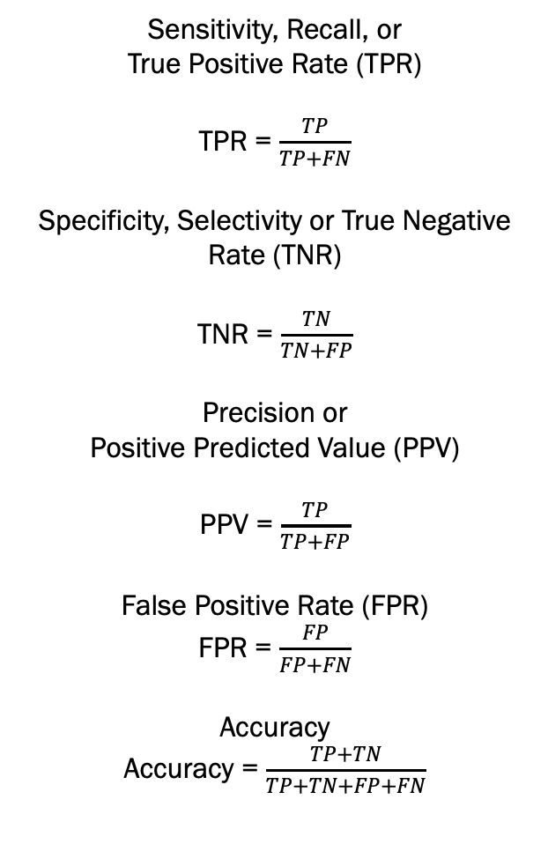
Binary Classification
Sensitivity, Recall, or
True Positive Rate (TPR)
TPR = $\frac{TP}{TP+FN}$
Specificity, Selectivity or True Negative Rate (TNR)
TNR = $\frac{TN}{TN+FP}$
Precision or
Positive Predicted Value (PPV)
PPV = $\frac{TP}{TP+FP}$
False Positive Rate (FPR)
FPR = $\frac{FP}{FP+FN}$
Accuracy
Accuracy = $\frac{TP+TN}{TP+TN+FP+FN}$
Confusion Matrix
 |  | Actual Class
 |  | False(0) | True(1)
Predicted Class | False (0) | True Negative (TN) | False Negative (FN)
 | True (1) | False Positive (FP) | True Positive (TP)

Slide 4
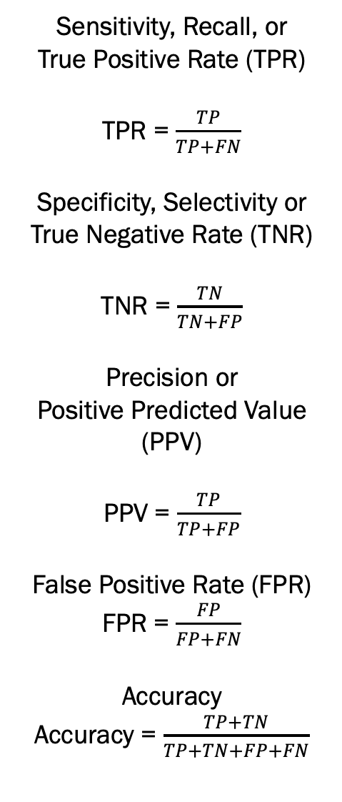
Binary Classification
Sensitivity, Recall, or
True Positive Rate (TPR)
TPR = $\frac{TP}{TP+FN}$
Specificity, Selectivity or True Negative Rate (TNR)
TNR = $\frac{TN}{TN+FP}$
Precision or
Positive Predicted Value (PPV)
PPV = $\frac{TP}{TP+FP}$
False Positive Rate (FPR)
FPR = $\frac{FP}{FP+FN}$
Accuracy
Accuracy = $\frac{TP+TN}{TP+TN+FP+FN}$
To further confuse, classes are often flipped.
 |  | Actual Class
 |  | True (1) | False(0)
Predicted Class | True (1) | True Positive (TP) | False Positive (FP)
 | False (0) | False Negative (FN) | True Negative (TN)
https://en.wikipedia.org/wiki/Confusion_matrix

Slide 5
What is a ROC curve and Why do I Care?
A receiver operating characteristic curve, or ROC curve, is a graphical plot that illustrates the diagnostic ability of a binary classifier system as its discrimination threshold is varied.
Basically it is a measure of how well a model can discriminate between two classes
The ROC curve was first developed by electrical engineers and radar engineers during World War II for detecting blips on radar screens. ROC analysis since then has been used in medicine, psychology, radiology, biometrics, forecasting of natural hazards, meteorology, marketing, fraud detection, etc.
ROC curves simply plot FPR associated w. Probability Thresholds against the TPR

Slide 6
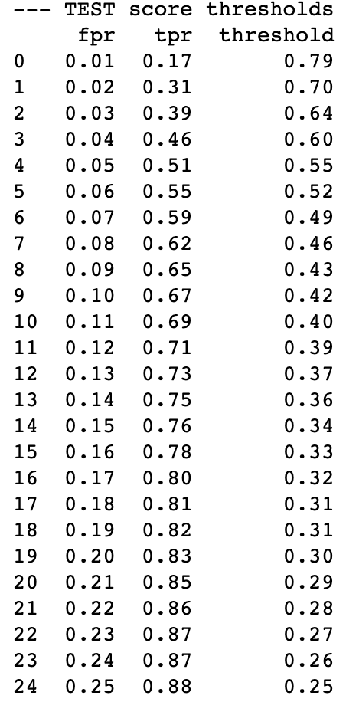
Roc Curve

Slide 7
What is AUC “area under the curve”
What is the Area of a 1 X 1 Square?
That’s easy 1
What is ½ the Area of a 1X1 Square?
That’s easy too 0.5

Slide 8
How to use a Roc Chart
TPR 0.8
TPR
FPR
Threshold 0.9 FPR 0.1

Slide 9
How to use a Roc Chart
--- TEST score thresholds ---
fpr tpr threshold
0 0.01 0.34 0.79
1 0.02 0.43 0.70
2 0.03 0.50 0.63
3 0.04 0.55 0.58
4 0.05 0.59 0.54
IF score_1 >= 0.54 THEN predict income >50K
This ”should” result in a TPR rate of 59% and a FPR of 5%

Slide 10
What variables were most influential?
The default method to compute variable importance is the mean decrease in impurity (or gini importance) mechanism: At each split in each tree, the improvement in the split-criterion is the importance measure attributed to the splitting variable, and is accumulated over all the trees in the forest separately for each variable. Note that this measure is quite like the R2 in regression on the training set.
The scikit-learn Random Forest feature importance and R's default Random Forest feature importance strategies are biased. To get reliable results in Python, use permutation importance, provided in rfpimp package (via pip).
We don’t really care at this point just know there is debate among data scientists
AND there are alternatives ~ permutation importance, drop column, shapley values and others.

Slide 11
Variable Importance
model['classifier'].feature_importances_
SKLEARN RF has a tendency to inflate the importance of continuous features or high-cardinality categorical variables

Slide 12
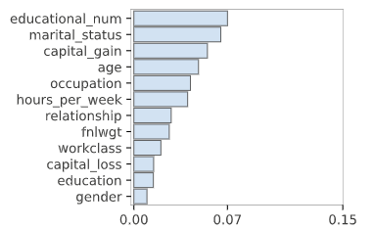
Variable Importance
from rfpimp import *
I = importances(rf, train[categorical_features + numeric_features], train[target])
plot_importances(I)

Slide 13
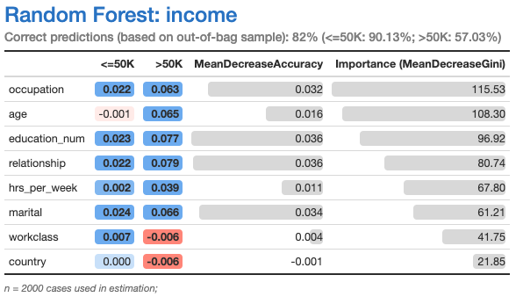
Variable Importance
Depending on the measure used by RF there can be wild variation in which variables are most important with Random Forest.
This is why most have switched to either Random Permutations, LOCO or Shap to evaluate the true importance.

Slide 14
Target Encoder
Instead of One hot encoding 1/0s for every category level
Target encoding simply replaces each level with it’s % of target value
pd.crosstab(train["relationship"],train[target], normalize="index").reset_index()
 | relationship | 0 | 1
0 | Husband | 0.551589 | 0.448411
1 | Not-in-family | 0.898478 | 0.101522
2 | Other-relative | 0.956814 | 0.043186
3 | Own-child | 0.985072 | 0.014928
4 | Unmarried | 0.941808 | 0.058192
5 | Wife | 0.538320 | 0.461680

Slide 15
Label Encoder
Instead of converting each level to a 0/1
Label encoder simply gives each level a number from 0 to number of levels
from sklearn import preprocessing
le = preprocessing.LabelEncoder()
le.fit(train["relationship"])
le.transform(["Husband", "Not-in-family",
"Not-in-family",
"Unmarried"])
array([0, 1, 1, 4])

Slide 16
Most of your predictive power is found in categorical data...
Frequency Encoding
Given the frequency pct of the level
https://towardsdatascience.com/all-about-categorical-variable-encoding-305f3361fd02

Slide 17


